Slide 1

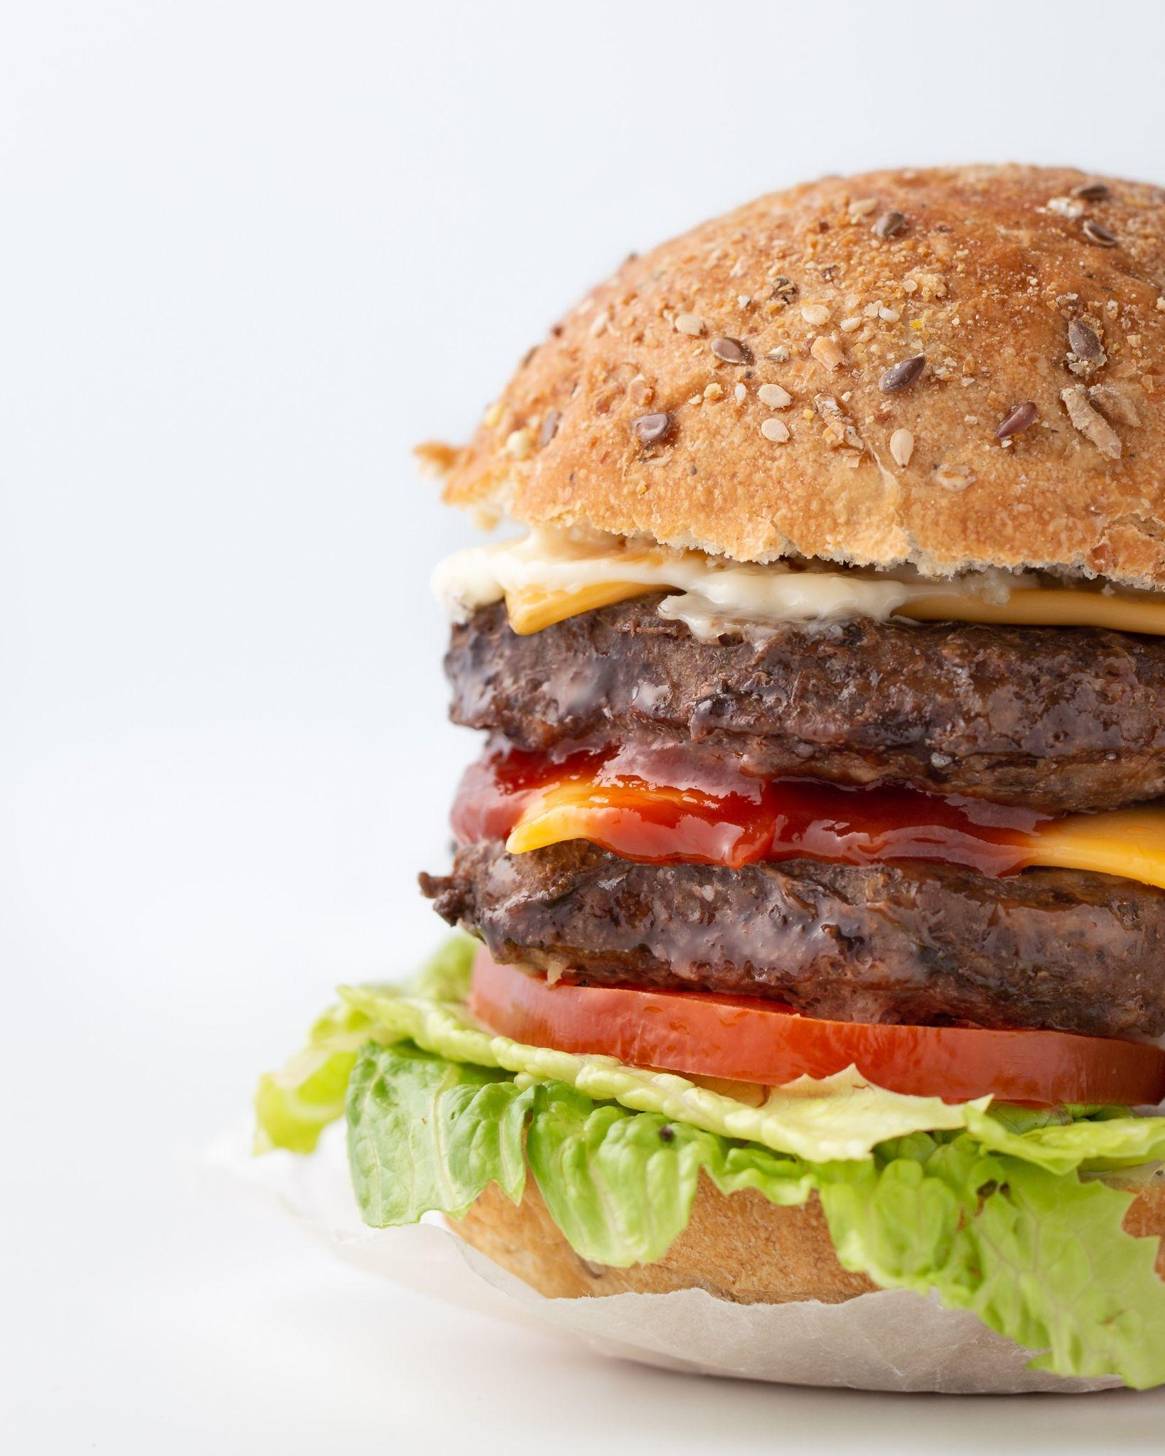
Optimal Online Food Delivery
Group 9 Alyssa Nusantoro, John Markowicz, Jonathan Suarez, Leanne Tong, Maxim Zahra, Ryan Ko, Surabhi Srikanth

Slide 2

Project Question:
What factors affect the time it takes to complete a food delivery order?
Predictors
City Type
Distance
Pickup Time
Placed Order Time
Weather
Traffic
Delivery Type
Multiple Deliveries
Vehicle Type
Vehicle Condition
Delivery Person Age
Delivery Person Rating
Outcome Variable
Amount of Time Taken for Delivery
Notes:
From proposal

Slide 3
Why is This Problem Important?
In 2022, it was reported that 2.5 billion people worldwide used food delivery services.
By 2027, it is estimated for that number to increase to 3.5 billion people.
For most customers, the most important factors found in food delivery service is timely food delivery and quality customer service.
From a business perspective, it is important to understand this problem because it helps with:
Customer Satisfaction
Competitive Advantage
Operational Efficiency
Adaptation to Market Trends
Customer Insights and Feedback

Slide 4



Amazon Business Research Analyst Dataset
Data Overview
Numerical Variables
Categorical Variables
Sourced from Kaggle
Prior to Cleaning: 2,442 Rows
Post Cleaning:
2,118 Rows
20 columns
Restaurant Location
Delivery Location
Order Date & Time
Order Pickup Time
Order Placed Time
Delivery Person Age
Delivery Person Rating
Type of Order
City (metro, urb, semi-urb)
Type of Vehicle
Vehicle Condition
Road Traffic Density
Weather Condition
Multiple Deliveries
Notes:
From proposal

Slide 5
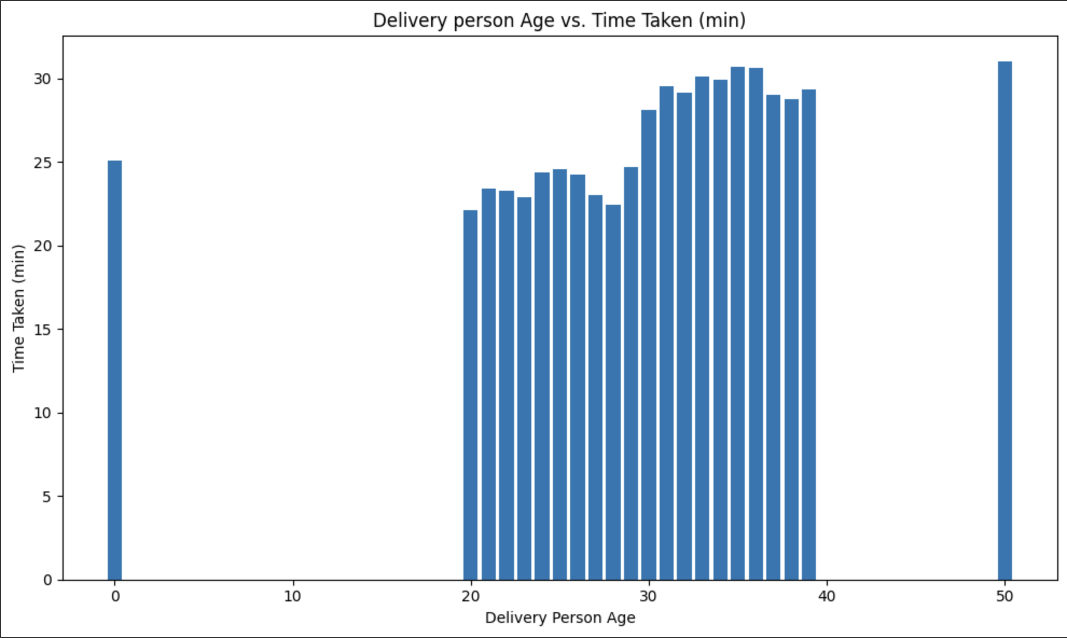
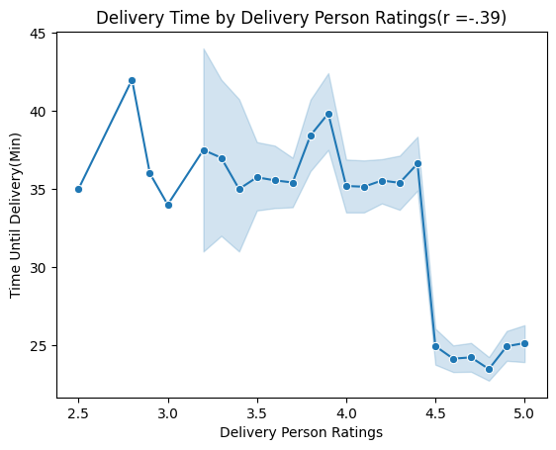
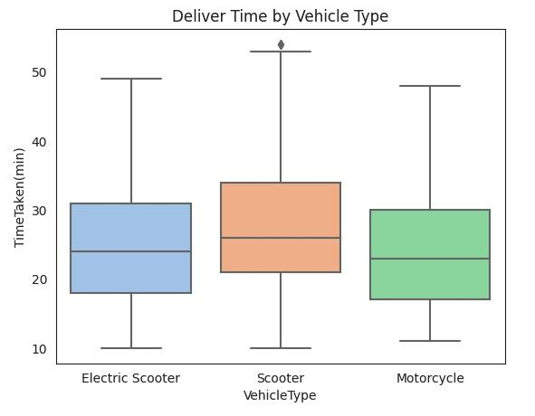
Initial Exploration in the Data
Generally, delivery people who are older in age tend to have longer delivery times for orders they complete.
Generally, there appears to be a negative relationship between delivery person rating and delivery time.
Generally, certain vehicles like scooters appear to have a longer median delivery time than motorcycles.

Slide 6
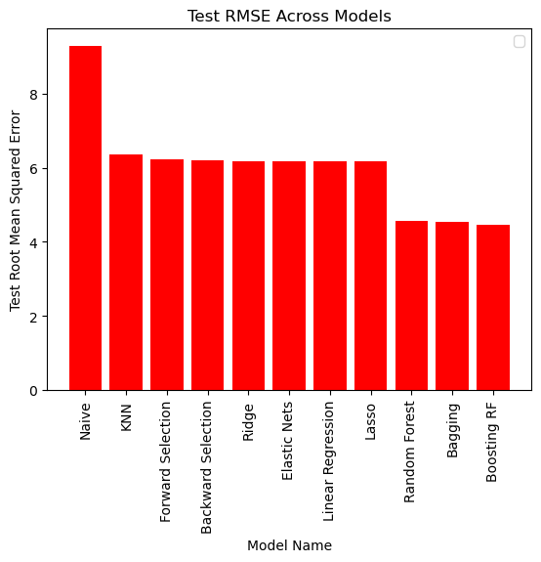
Test RMSE Values Comparison
Least Accurate: KNN
As shown in the graph, the model with the highest test RMSE (apart from the baseline model) was KNN.
Most Accurate: Boosted RF
Boosting is a technique that relies on many weak learners and iteratively updates the overall model by improving upon the errors made.
AdaBoost assigns higher weighted values to samples with high error rate, so that the model can learn from the residuals.
Many different factors affect food delivery time at different levels, so the test RMSE here was lower.
Notes:
Answering the research question

Slide 7
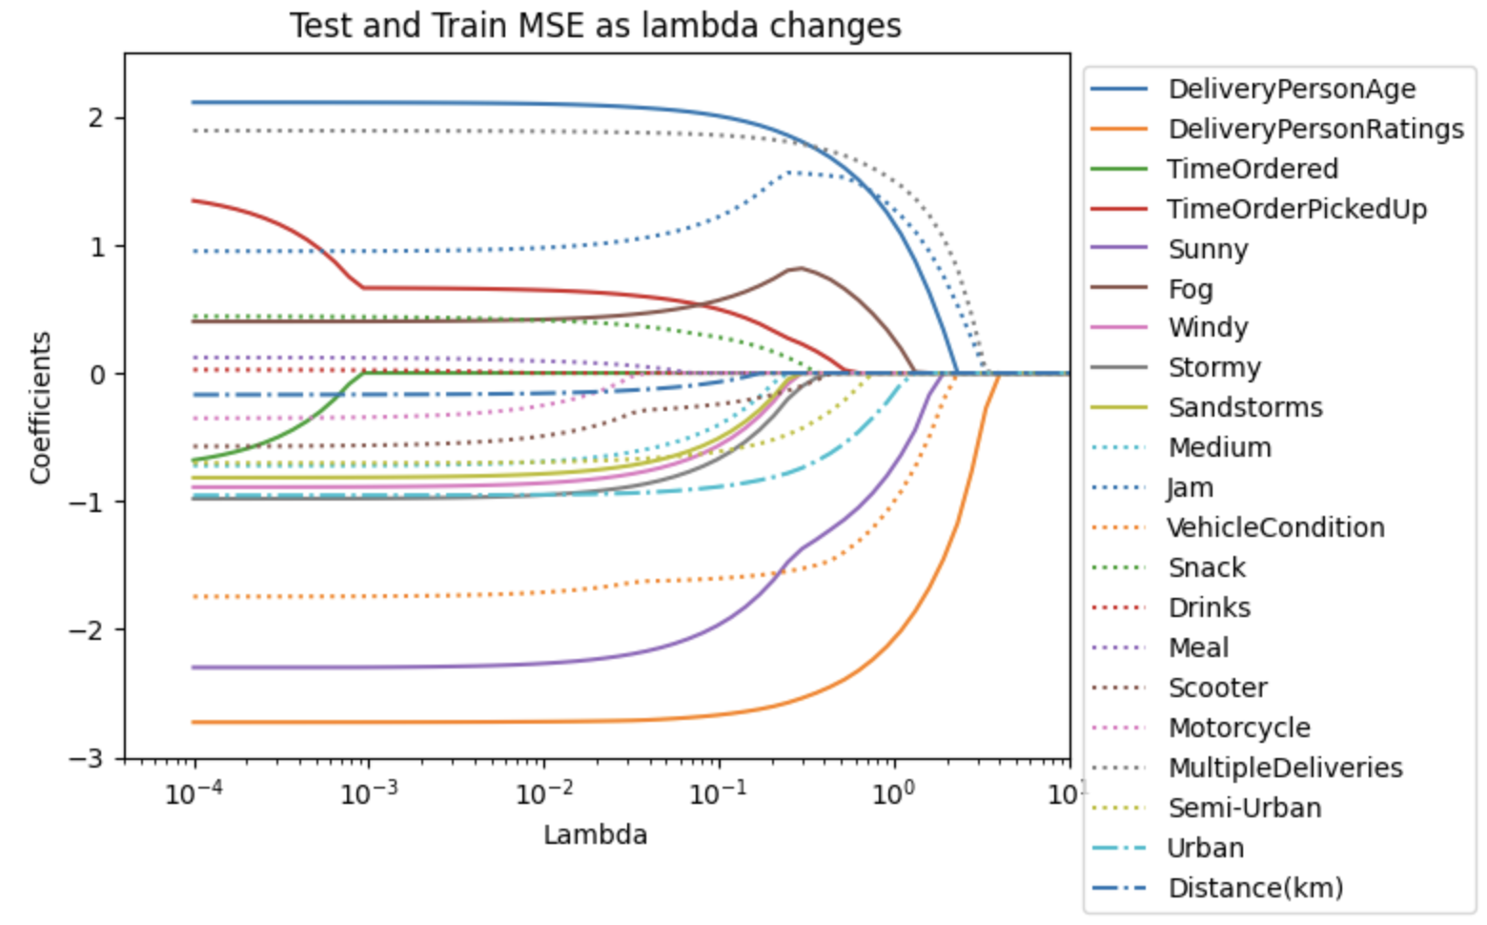
Lasso: Main Factors that Affect Prediction of Delivery Time
Top 5 Most Important Factors that Impact Delivery Time:
Delivery Person Ratings
Multiple Deliveries
Traffic Jam
Delivery Person Age
Vehicle Condition

Slide 8
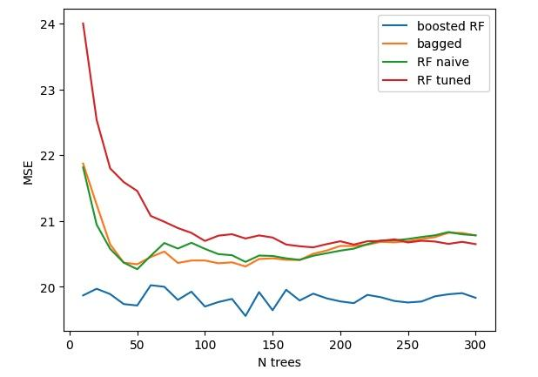
Ensemble Methods Yield the Lowest MSE in Our Dataset
MSE as Function of Number of Trees
Ensemble methods rely on a collection of many decision trees, which handle categorical data effectively.
Random forests successfully capture nonlinear relationships between features and target variables.
By averaging the predictions of many decision trees, model variance is mitigated without any subsequent increase to model bias.

Slide 9
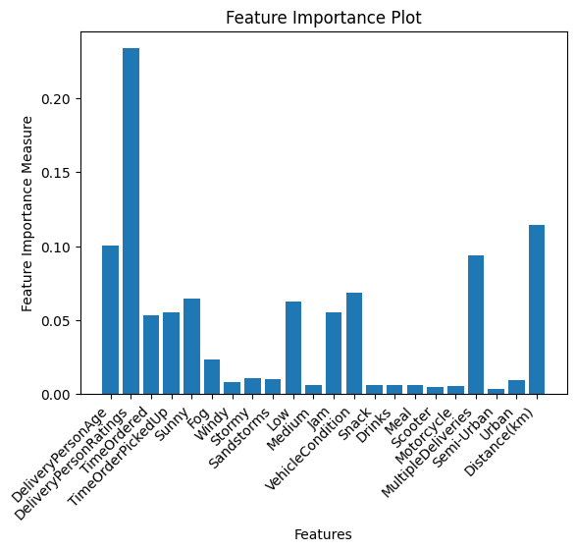
Random Forest: Main Factors that Affect Prediction of Delivery Time
Top 5 Most Important Factors that Impact Delivery Time:
Delivery Person Ratings
Distance
Delivery Person Age
Multiple Deliveries
Vehicle Condition
Variable importance is computed using the Gini coefficient across all trees. A feature is considered important if its use in splitting the data causes a significant reduction in MSE.

Slide 10
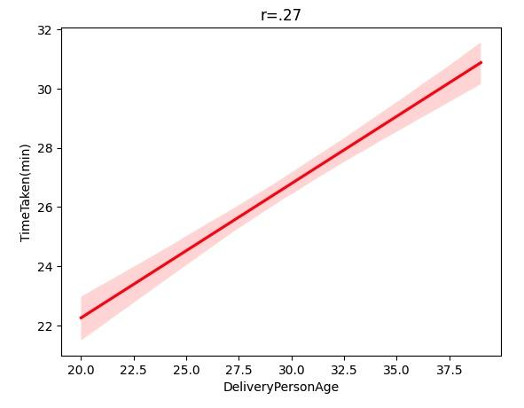
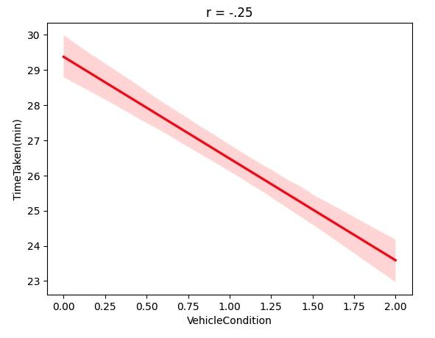
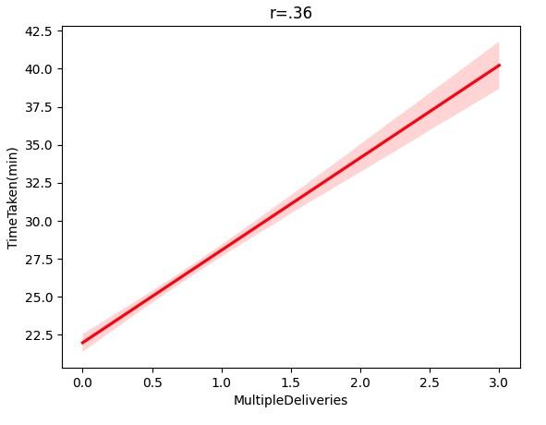
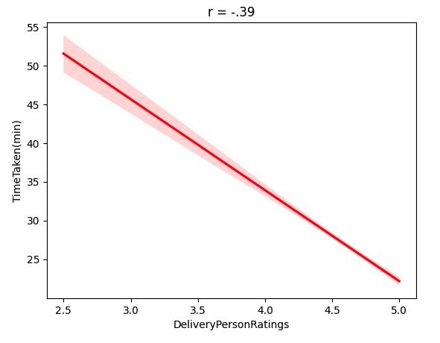
Results Summary
Project Question:
What factors affect the time it takes to complete a food delivery order?
Based on the Ensemble and Lasso methods used, common factors found to be of importance to the outcome variable are:
Delivery Person Ratings
Delivery Person Age
Multiple Deliveries
Vehicle Condition

Slide 11


Challenges Faced
Dummy Variables
Random Forest and Boosting Model Took A Long Time to Run
Dummies had to be created for several categorical columns, such as weather, traffic, city, etc.
Error in the dummy variables code resulted in no showing of 0 or 1 values, but showed all 0 values instead.
Prior to fixing the code, this resulted in a higher train MSE to its test MSE.
Took at least an hour that resulted in a memory error or an early termination of the running code.
In a real business scenario, this shows how using certain algorithms requires more resources and time, which can be costly.

Slide 12
Final Conclusions
By exploring this dataset and testing out different algorithms, we were able to learn more about how various data scientists approach real-life scenarios. We learned:
Different datasets often require a unique approach when it comes to choosing the ideal algorithm(s) that will provide the best results. For example, despite the fact that certain models had lower test MSEs for our dataset, we understood that from a business perspective, these models are not necessarily useful for interpretation by business managers.
In a real business scenario, we could do more in-depth exploratory data analysis to help with learning about trends and overall patterns that can be explained to managers. Moreover, we can pick algorithms that are easily interpretable but still provide the benefit of increasing the accuracy of predictions.

Slide 13
Thank you!

